Slide 1



TA Chatbot
Semester Year Team: Student1 (Major1), Student2 (Major2), …
Organize the information in this space in any way you choose provided you cover the required contents
Required Contents (suggest you use the words in bold as headings)
Purpose (ultimate project goals & sponsor benefits)
Past Work and/or Project History (as appropriate)
Semester Objectives/Requirements (specific desired results this semester, include a (system) diagram indicating what you are designing)
Technical Approach, Results and Accomplishments to Date (analysis, design, resulting artifacts, evaluations and test results, tentative conclusions, etc)
Next Steps and Plan (How you plan to succeed, what are your scheduled next steps)
Above descriptions are for MIDTERM poster content. FINAL poster should be update of what team actually achieved during semester, and future direction of project.
Use a plain background. No background picture please.
Font of bulleted text should be 66 pt or larger, annotations and axis labels 48 pt or larger
No confidential information.
For RPI sponsored projects, use this logo ->
Sponsor Mentor(s): Name1, Name2, … ; Project Engineer: Name (Dept.); Chief Engineer: Name (Dept.)

Slide 2
Previous slide was a TEMPLATE for the poster. This slide contains INSTRUCTIONS for the poster
Detailed notes are (of course) on EDN
https://designlab.eng.rpi.edu/edn/projects/capstone-support-dev/wiki/Preliminary_Design_Review_and_Poster/
DO NOT use glossy paper. It is twice the cost and glare from classroom lights make it hard to read.
Printed full size this will be 3ft x 4ft – Help Desk has printing instructions (sadly not posted on-line)
Your Project Engineer’s department is probably “CORE”
DO NOT put your Gantt chart on the poster. Don’t print it, mention it, show it. It is too small and detailed for the 25 min schedule.
Abbreviations of Majors
Mechanical – MECL Electrical - ELEC
Computer Systems – CSYS Computer Science - CSCI
Materials – MATL Industrial - MGTE
Aeronautical – AERO Biomedical - BMED
USE this poster as an aid during presentation. Point to pictures, highlight data and graphs. If you draw a blank, just talk about the next section to get back on track.
Some examples of past FINAL posters are hanging in classroom & online for reference. https://designlab.rpi.edu/projects

Slide 3
Purpose (ultimate project goals & sponsor benefits)
[bulleted list of short sentences/phrases pulled from existing Statement of Work - Introduction & Semester Objectives sec. 1&2]

Slide 4
Past Work and/or Project History (as appropriate)
[bulleted list of short sentences/phrases pulled from existing Statement of Work - Introduction sec. 1]

Slide 5
Semester Objectives/Requirements (specific desired results this semester, include a (system) diagram indicating what you are designing)
[bulleted list of short sentences/phrases pulled from existing Statement of Work - Project/Semester Objectives sec. 2]
For non-software items, be sure to include measurable specifications as appropriate.
For software items, be sure to clearly define the functional requirements and how they can be confirmed/verified, e.g. tests, use cases, etc.

Slide 6
Technical Approach, Results and Accomplishments to Date (analysis, design, resulting artifacts, evaluations and test results, tentative conclusions, etc)
[Tech Approach - bulleted list of short sentences/phrases pulled from existing Statement of Work - Engineering Tools & Methods sec. 3]
[Results and Accomplishments - bulleted list of short sentences/phrases of what team has ACTUALLY accomplished by day of Preliminary Design Review, LABELED images, graphs, pictures]

Slide 7
Next Steps and Plan (How you plan to succeed, what are your scheduled next steps)
[bulleted list of short sentences/phrases pulled from existing SoW - Deliverables & Dates Appendix A]
Function | Options | Ease of implementation (0–10) | Performance (0–10) | Resource efficiency (0–10) | Select? (Y/N)
Deployment | Integrate into EDN | 0 | 10 | 0 | N
 | Webex bot | 8 | 9 | 8 | Maybe
 | Standalone webpage | 4 | 7 | 5 | Maybe

Slide 8
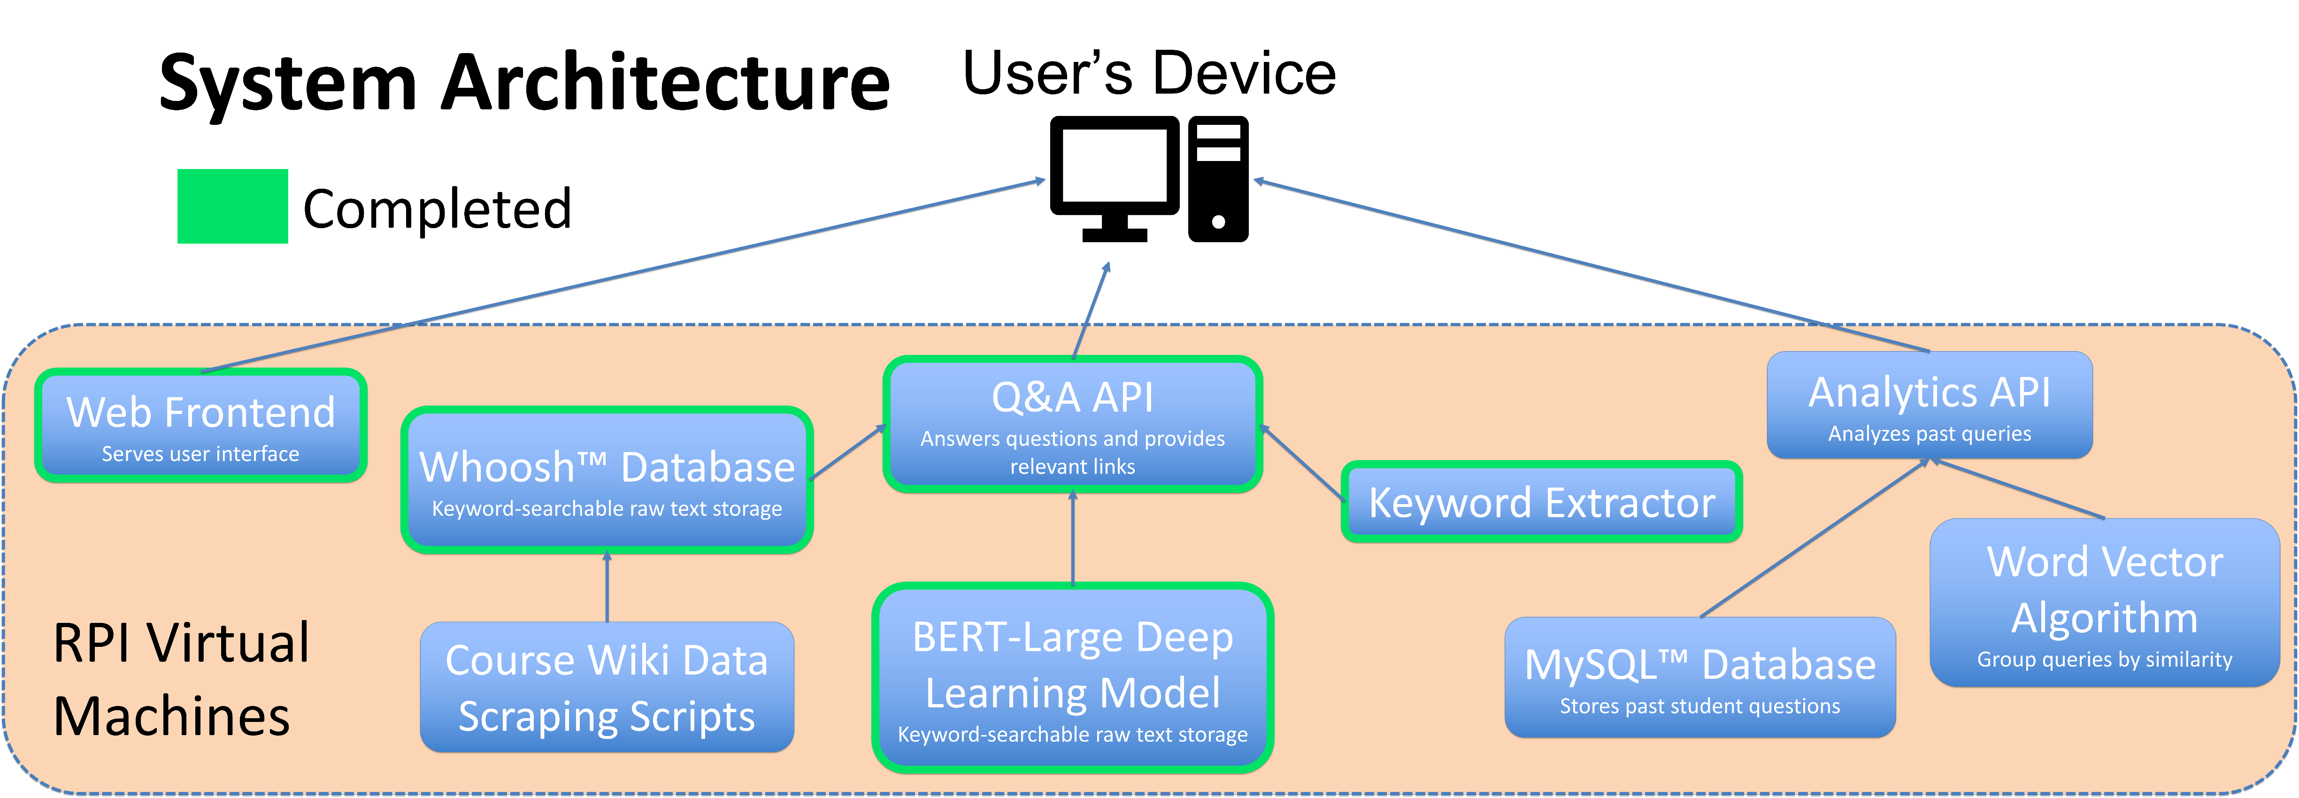
Chatbot Teaching Assistant
Jonah Que (CSYS / 2022), Roland Rao (CSCI & CSYS / 2022), William Thramann (ISME / 2022), Zhuoming Wu (ELEC / 2022), Leyang Zhang (CSYS / 2022), Sandor Magyar (CSYS & CSCI / 2022), Megan Stahl (CSYS / 2022), Mitesh Kumar (CSCI & CSYS / 2022), Zachary Johnson (CSYS / 2022)
Purpose
Technical Approach
Chatbot to help students find Capstone Design course info on the Electronic Design Notebook (EDN) wiki faster than existing search
Improve student productivity, reduce instructor burden, keep instructors informed of student needs
Guide improvements to wiki over time
Semester Objectives
Bot provides a sensible English answer to questions
Bot retrieves links to relevant wiki pages
Bot's knowledge base can be updated when wiki changes
Bot can answer self-contained (single–chat message) questions
Show common questions to instructor, grouping similar ones
Current Implementation of Q&A Subsystem
BERT Large model architecture – Language Understanding
(Bidirectional Encoder Representations from Transformers)
Fine-tuned for question answering purpose on SQuAD Dataset
Current Example Query:
Question: What is Capstone?
Context: Welcome to capstone, an engineering design course.
Specifications
0.1 | 0.2 | 0.5 | 0.4 | 0.3 | 0.2 | 0.1
Start Confidence:
Preferable to wiki search for 60% of users
Sensible answer 50% of the time
Correctly judge whether answer can be found in knowledge base 80% of the time
Arrive at final answer within 1 minute
Handle at least 100 simultaneous users
Instructor can update knowledge base in 10 minutes
End Confidence:
0.9 | 0.3 | 0.2 | 0.1 | 0.2 | 0.5 | 0.8
Token Vector:
capstone | , | an | engineering | design | course | …
Fuzzy keyword search to generate context using whoosh™ database
Concept Selection
Results and Accomplishments
Customer Need(s) | Concept Name | Ease of Implementation (0–10) | Performance (0–10) | Resource efficiency (0–10) | Select (Y/N)
Fast response | Keyword search | 10 | 10 | 10 | Y
Natural Language Processing | Convolutional neural network | 0 | 2 | 10 | N
 | BERT architecture | 2 | 5 | 10 | Y
Accuracy | BERT large | 2 | 10 | 3 | Y
 | BERT small | 2 | 2 | 5 | N
Accomplishes question answering, relevant wiki page retrieval
Integrated with React.js frontend as testing interface
Next Steps
Write and evaluate alternative Webex frontend
Create logging system
Implement query analytics
Improve scraped wiki text data format
Sponsor Mentors: Evan Dodge, Kaitlyn Cavaretta, Timothy Richards, Rachel Woodard (Lockheed Martin) Project Engineer: Junichi Kanai (ECSE) Chief Engineer: Nima Ahmadi (ISE)

Slide 9
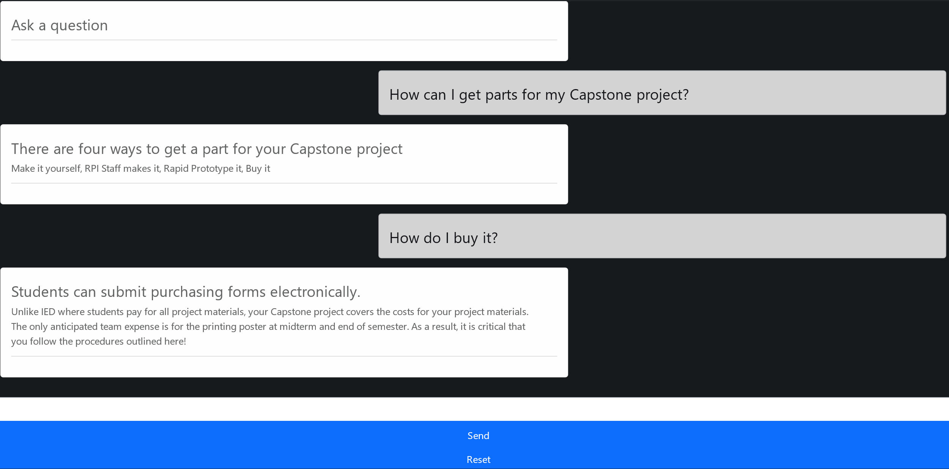
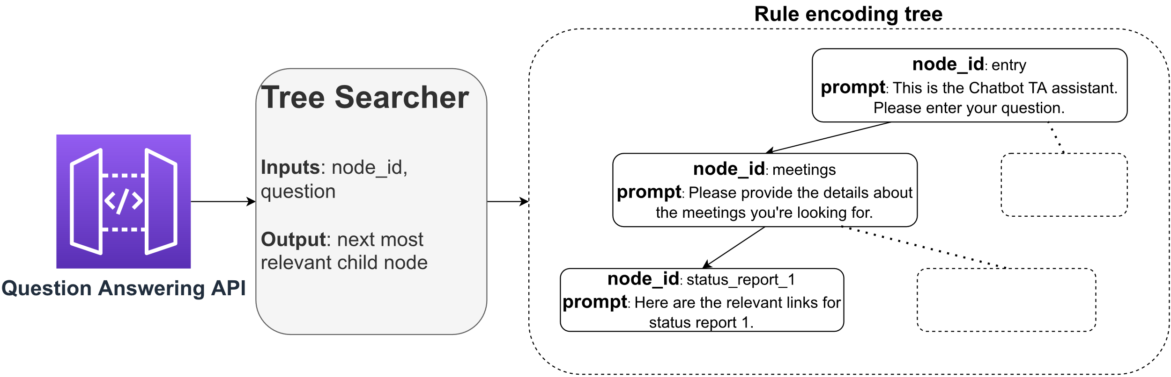
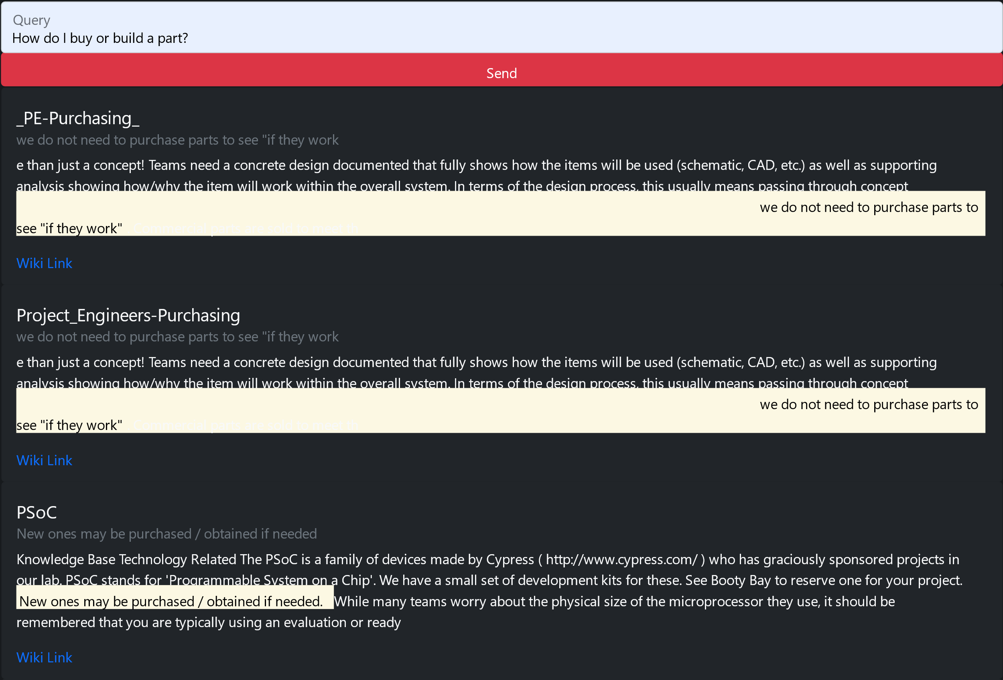
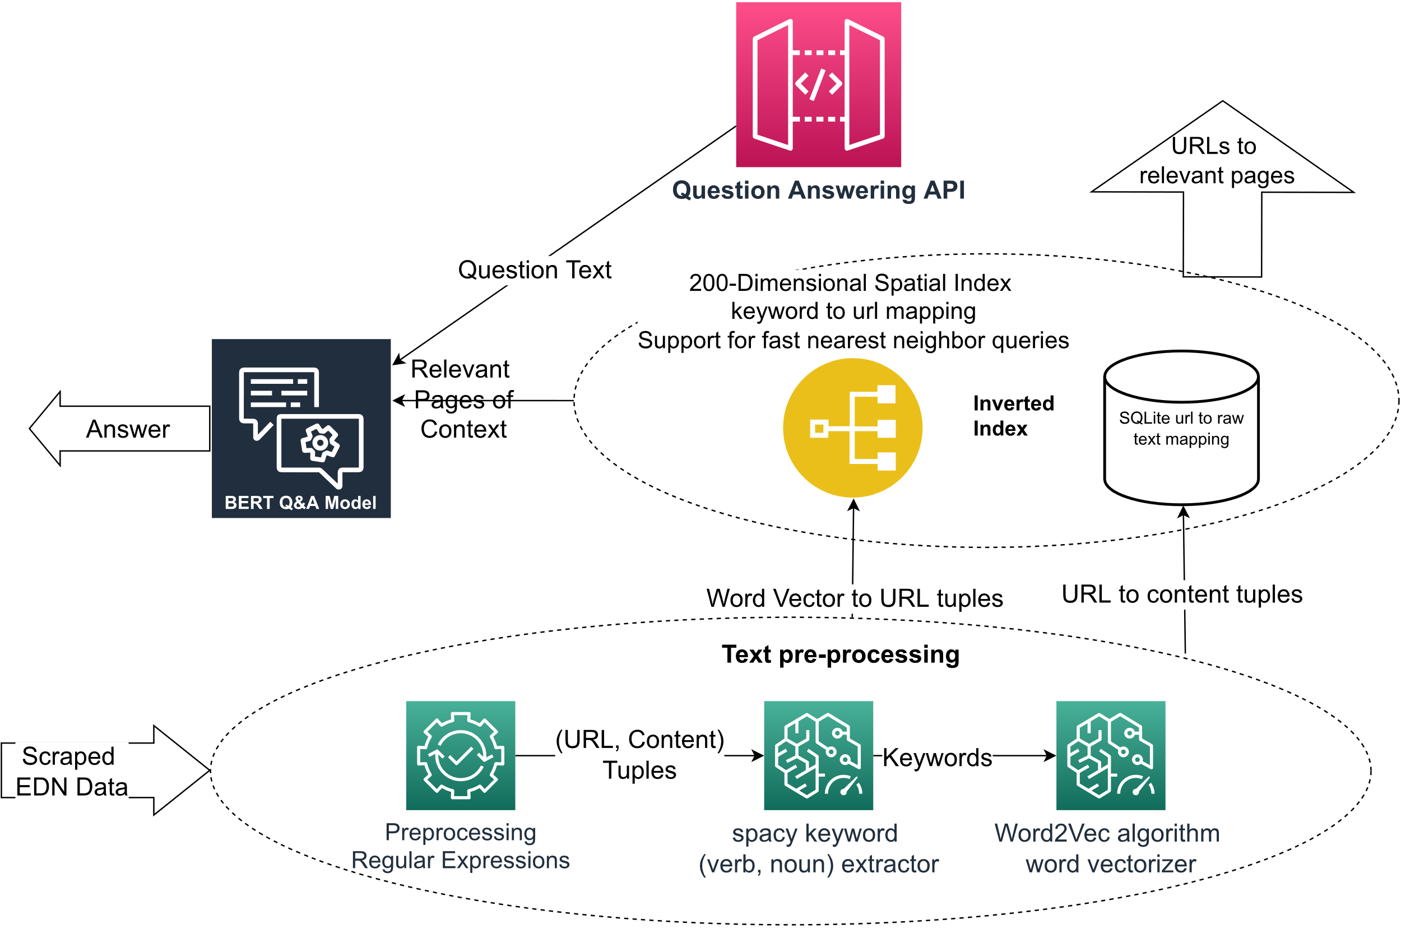
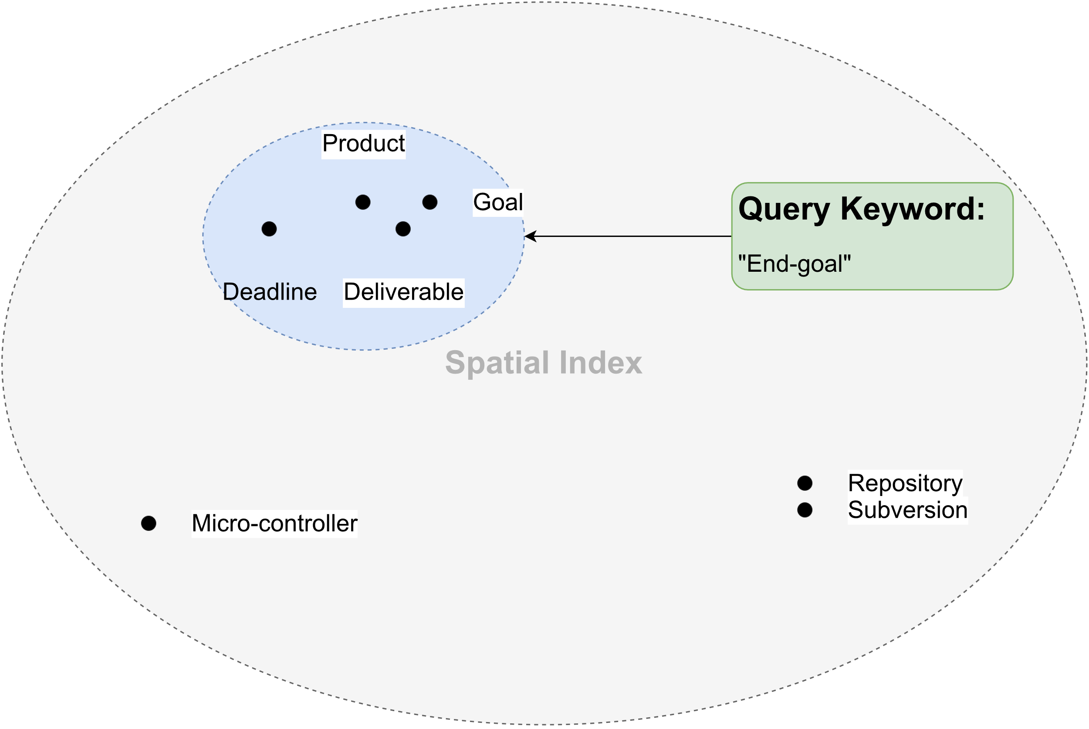
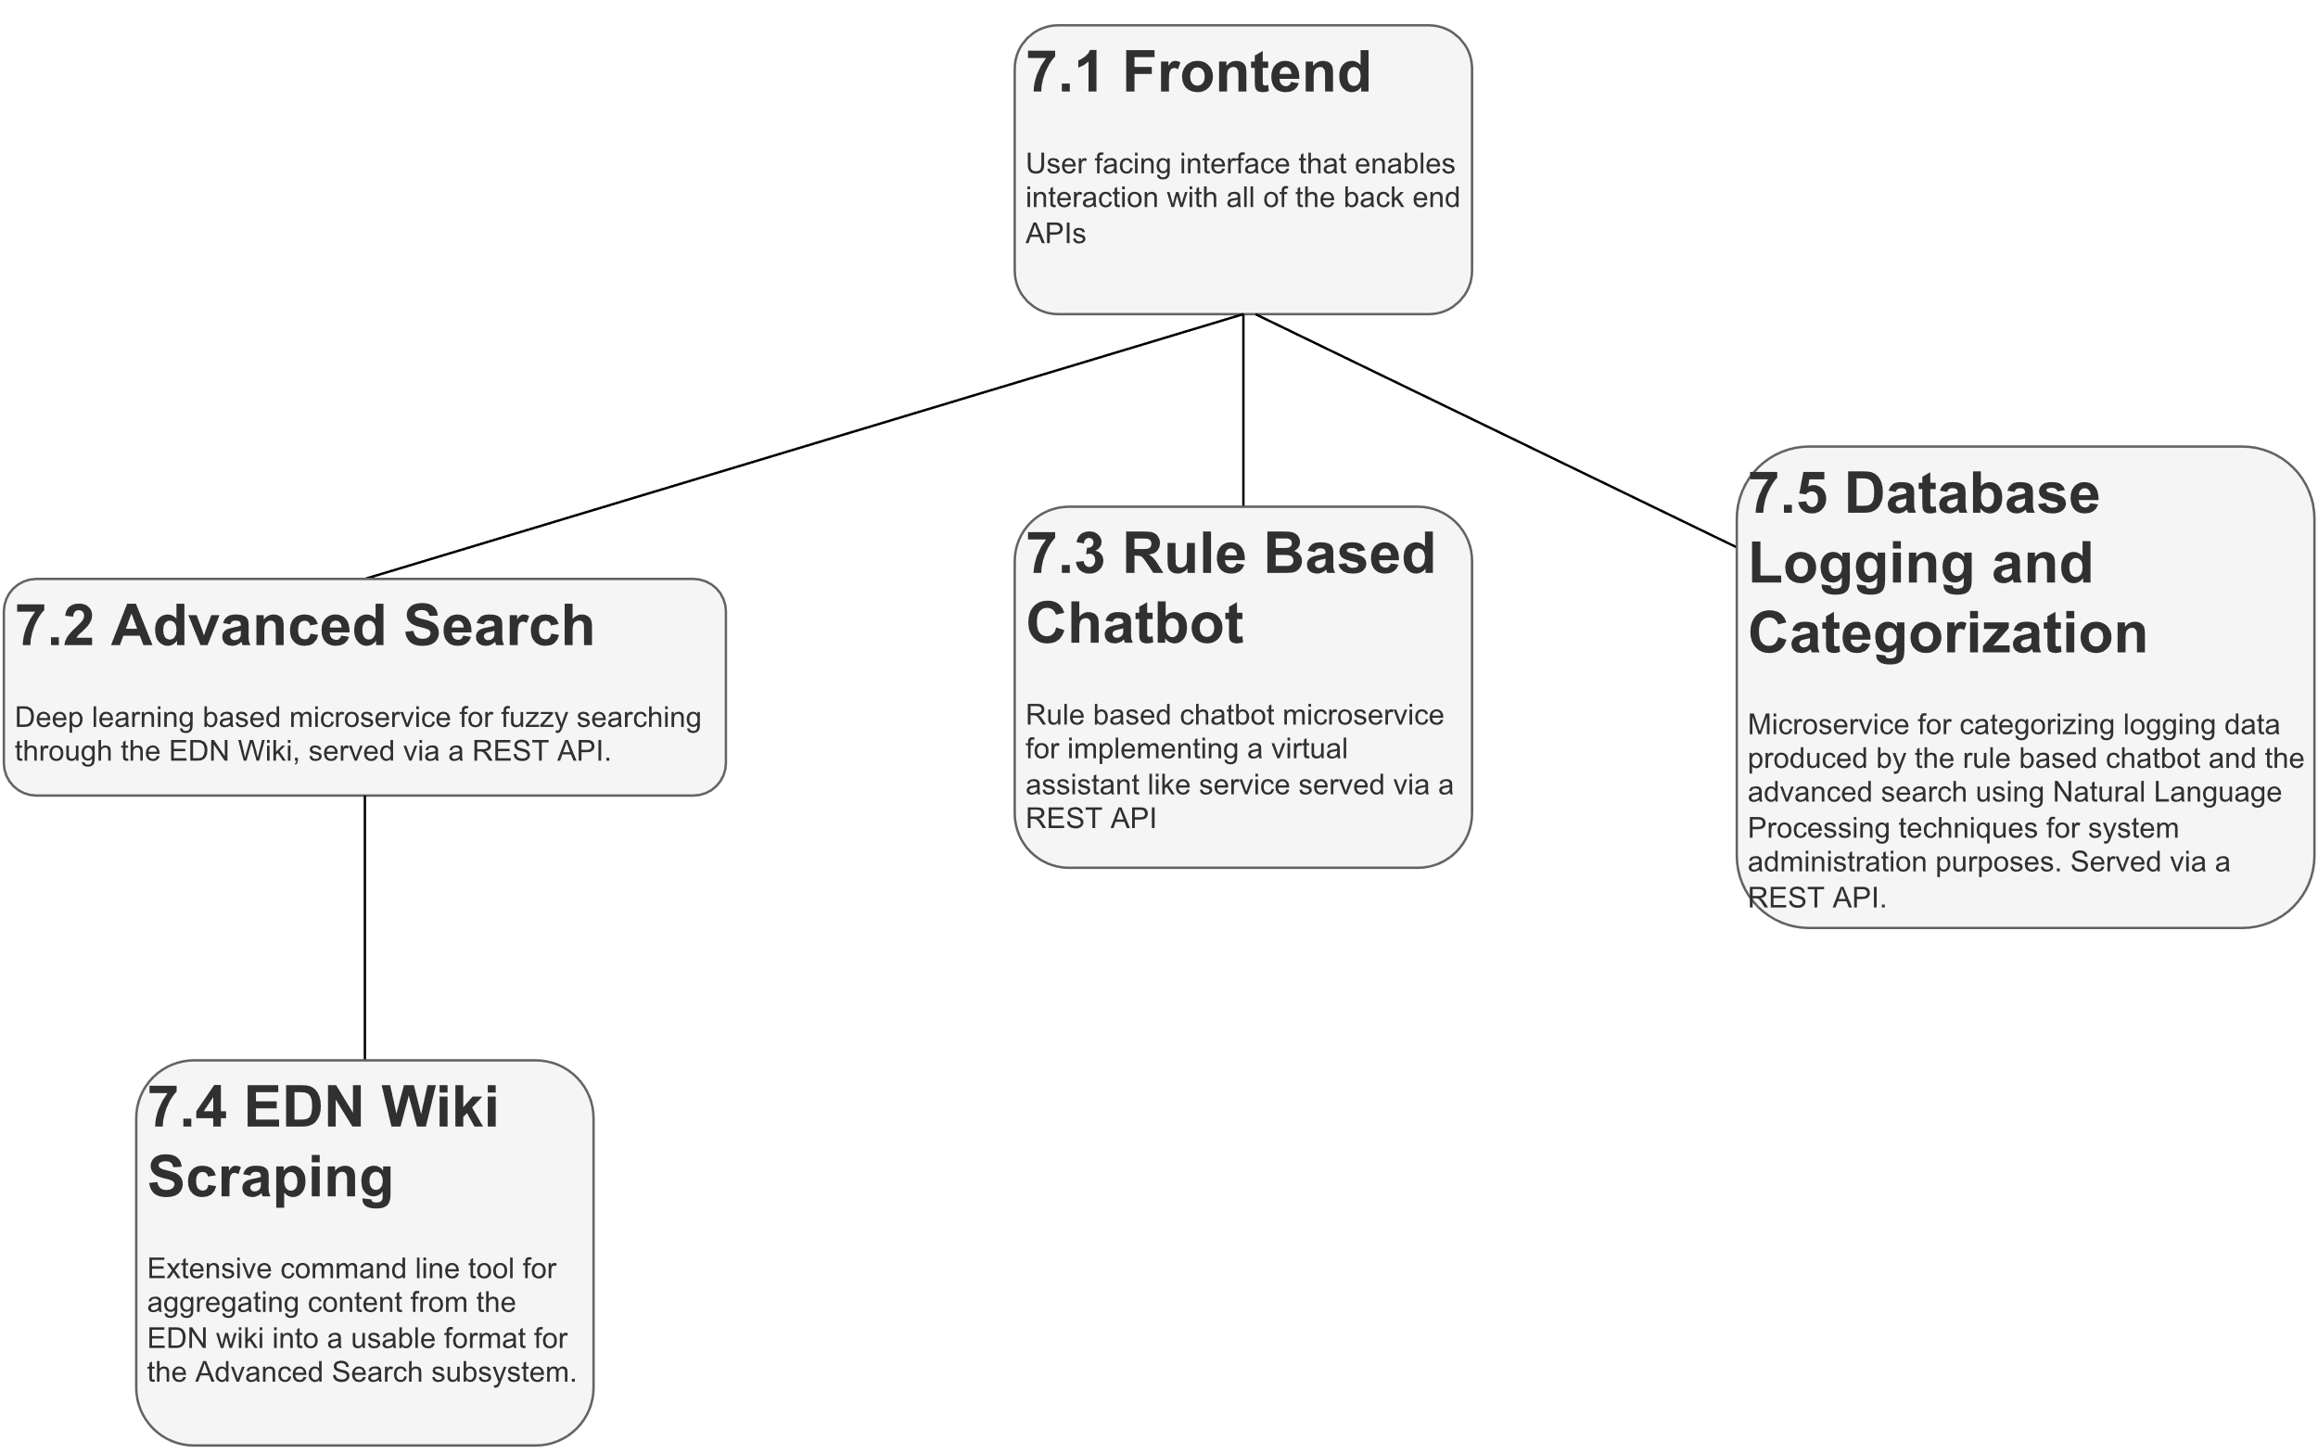
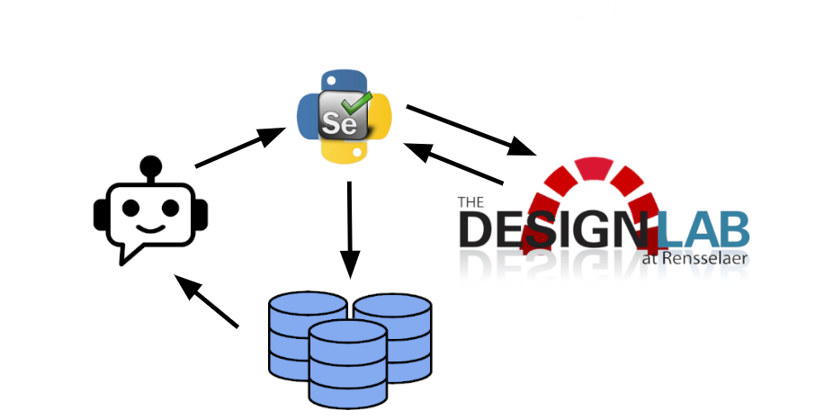
Chatbot Teaching Assistant
Spring 2022: Jonah Que (CSYS / 2022), Roland Rao (CSCI & CSYS / 2022), William Thramann (ISME / 2022), Zhuoming Wu (ELEC / 2022), Leyang Zhang (CSYS / 2022), Sandor Magyar (CSYS & CSCI / 2022), Megan Stahl (CSYS / 2022), Mitesh Kumar (CSCI & CSYS / 2022), Zachary Johnson (CSYS / 2022)
PURPOSE:
RULE BASED CHATBOT:
Chatbot to help students find Capstone Design course info on the Electronic Design Notebook (EDN) wiki faster than existing search
Improve student productivity, reduce instructor burden, keep instructors informed of student needs
Guide improvements to wiki over time
Rule Based Chatbot in Action
Decision Tree Chatbot Framework Demonstration
SEMESTER OBJECTIVES:
Automate sensible English answer to questions
Retrieve links to relevant wiki pages
Knowledge base can be updated when wiki changes
Answer self-contained (single–chat message) questions
Answer iterated (conversational message) questions
ADVANCED SEARCH:
Advanced Search in Action
Technical Design Overview
Spatial Inverted Index Demonstration
SPECIFICATIONS:
Preferable to wiki search
Retrieve sensible answers
Correctly judge whether answer can be found in knowledge base
Overall system responsiveness
Handle adequate simultaneous users
Instructor can update knowledge base quickly
SUBSYSTEM HIERARCHY:
EDN WIKI SCRAPING:
RESULTS:
FUTURE WORK:
Student query | EDN Search (s) | Chatbot (s) | Difference (s)
Where are the templates for design reports located? | 30 | 20 | -10
Where is the Statement of Work? | 15 | 38 | +23
Where do I submit the Statement of Work? | 65 | 10 | -55
Where do I submit the Preliminary Design Review, PDR? | 151 | 22 | -129
When is Phase 2 due? | 18 | 20 | +2
Where are the guidelines for purchasing located? | 20 | 8 | -12
What is the SMART acronym? | 30 | 12 | -18
Which Vendor has microcontrollers? | 233 | 28 | -205
How do I resolve an issue? | 81 | 45 | -36
How do I upload to the repository? | 160 | 25 | -135
How do I schedule a sponsor meeting? | 81 | 50 | -31
Implement distributed APIs to handle more users
Improve rule generation tool and documentation
Train own machine learning models based on EDN Wiki data for improved response accuracy
Redesign decision tree framework to allow for dynamic “next best edge” selection routines and custom form content for each node
Depth-first-search algorithm used to traverse all reachable EDN wiki sites
Selenium used to automate wiki site accesses for retrieving content
Time for a student to arrive at a useful answer using the chatbot or EDN search. Negative difference shows an improvement.
Sponsor Mentors: Evan Dodge, Kaitlyn Cavaretta, Timothy Richards, Rachel Woodard (Lockheed Martin) Project Engineer: Junichi Kanai (ECSE) Chief Engineer: Nima Ahmadi (ISE)

Slide 11

Summary of Engineering Tools
User’s Device
Completed
Web Frontend
Serves user interface
Q&A API
Answers questions and provides relevant links
Analytics API
Analyzes past queries
Whoosh™ Database
Keyword-searchable raw text storage
Keyword Extractor
Word Vector Algorithm
Group queries by similarity
RPI Virtual Machines
BERT-Large Deep Learning Model
Keyword-searchable raw text storage
Course Wiki Data Scraping Scripts
MySQL™ Database
Stores past student questions

Slide 12

System Design:
RPI Virtual Machines
2
Our server
Web Server
3
Q&A subsystem
4
Frontend client
1
User types message
Analytics subsystem
5
Bot responds

Slide 14
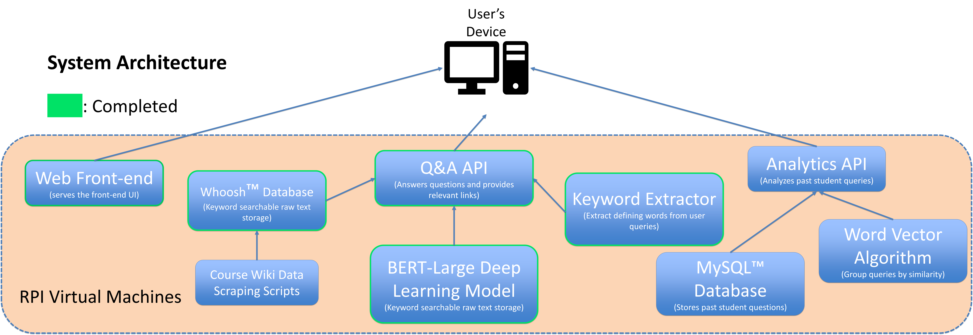

Slide 15
User’s Device
1. Web Frontend
Serves user interface
4. Q&A API
Answers questions and provides relevant links
7. Analytics API
Analyzes past queries
2. Advanced Search
Optimized document retrieval with context-based question answering
8. MySQL™ Database
Stores past student questions
9. Natural Language Processing
Group queries by similarity
RPI Virtual Machines
3. Course Wiki Data Scraping Scripts
2. Rule-based chatbot
Support for iterated conversational queries

Slide 16
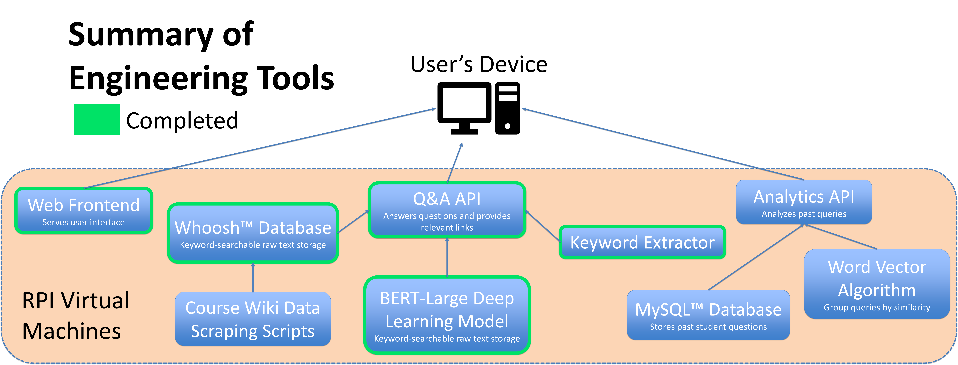

Slide 17
